Slide 1
Building an VR ship simulation
VCS2 Own proposal Hugo Leenen

Slide 2
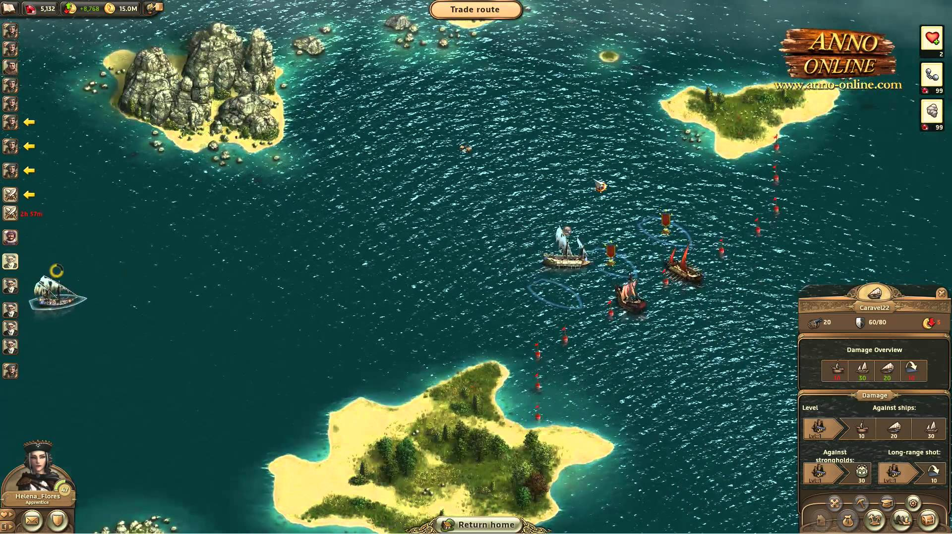
Goals
Display visual information
Replace traditional input devices
Create a fun to watch simulation

Slide 3
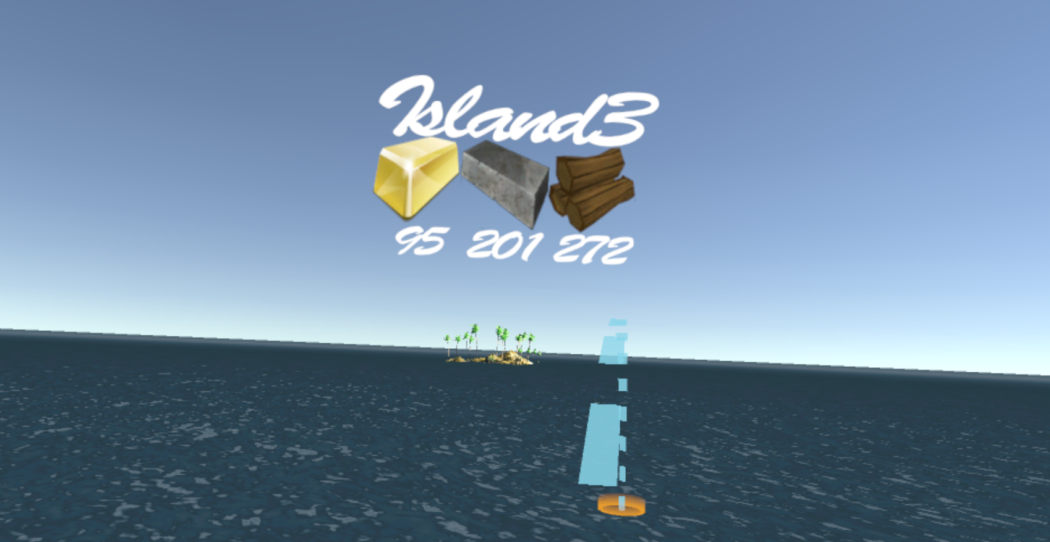
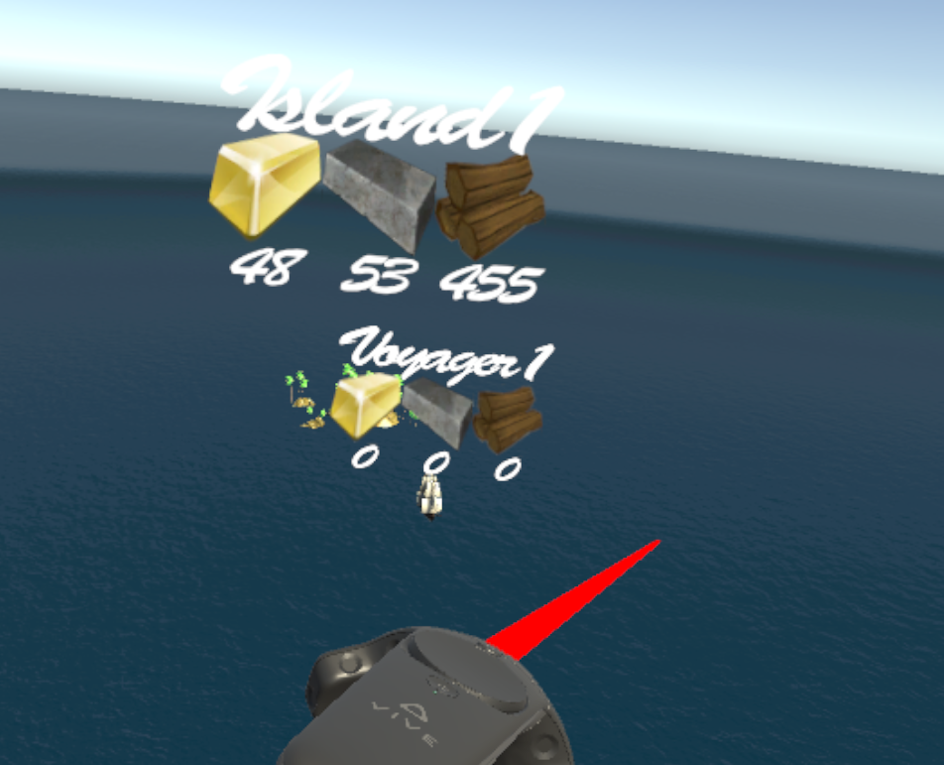
Results

Slide 4
Conclusion

